Slide 1
Early results on Treatment Recommendation System based on NLP
Shuai Xu
Department of Electrical Engineering,
University of Southern California

Slide 2
Why Treatment Recommendation System
On the professionals’ side
help them find the similar patients with similar symptoms and specific condition they have or good treatments they received, and to help doctor to come up ideas of treatments for new patients and identify drug prescription more accurately [3].
Improve the healthcare decision making.
On the patients’ side
analyze the user health status and monitor their lifestyle [4]
Personalization. Doctor with good patients’ feedback [5] or the right hospital to save money save time.
Helping patients find healthcare personalized precisely trustable therapy [6].
Notes:
For doctor: There are lots of new drug's release, it’s hard to remember all those records and prescript them accurately in a short time.
Patients: to dynamically provide some suggestions for the user in time, motivated them, like do more exercise, stop smoking, etc [4].

Slide 3
Related work
For the previous works, it covered some different NLP text mining similarity measures for sentence; collaborative filtering, knowledge-based (content-based filtering), and hybrid filtering recommendation based on trusting doctor-patient relationship [8], other ML algorithms, like decision tree, clustering, etc, or CF based on DL frameworks [3].
I use the lexical database (NLTK WordNet) and corpus statistics in NLP to measure the semantic similarity between words and words, sentences and sentences for Collaborative Filtering recommendation.
Use word association to blurry search the matched record in dataset.
Notes:
Use different vectorization methods: BoG, word2vec, TF-IDF
high blood pressure and hypertension

Slide 4
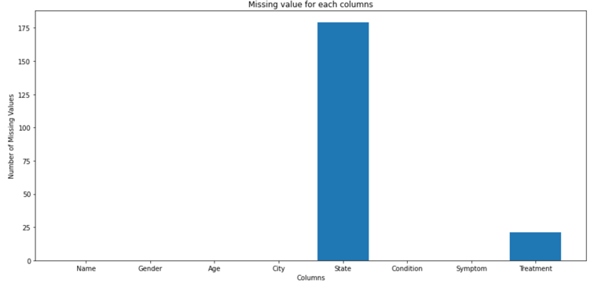

What I’ve done – dealing with missing values

Slide 5
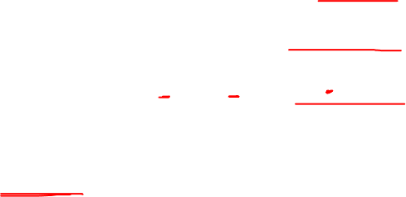
What I’ve done– data cleaning
ID | Gender | Age | City | State | Condition | Symptoms | Treatments
ferhad52 | Male | 63 | gonbad e qabus | golestan / province | Psoriasis | "Itching,Rashes (redness | Anxious mood,Pain",Psoriatic plaques (scaly patches)
macsoft | Male | 48 | S√£o Paulo | Brazil | Psoriasis | "Itching,Rashes (redness | Fatigue, swelling),Insomnia,Anxious mood
3349 -> 3286 data points

Slide 6
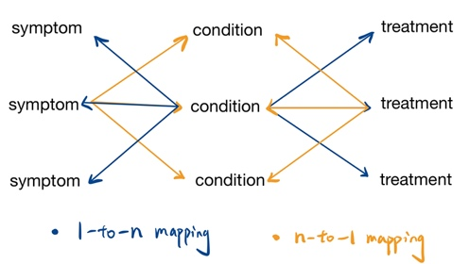

What I’ve done - mapping
Notes:
1 to N:
One condition will have several symptoms
One condition will have several conditions
N to 1:
One symptom might have different possible conditions
One treatment might treat several different conditions

Slide 7
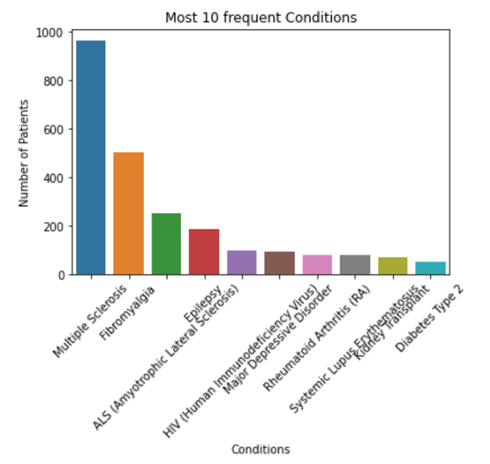
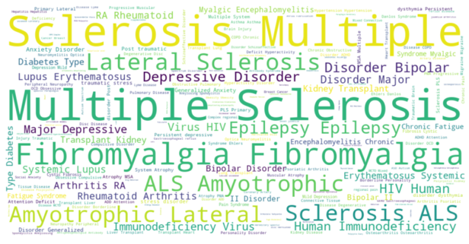
What I’ve done - conditions
240 unique conditions

Slide 8
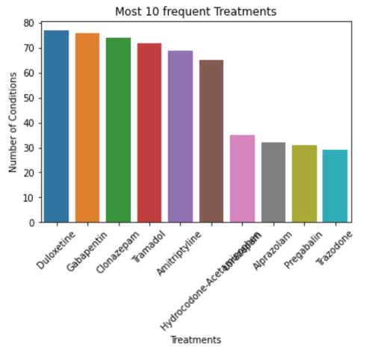
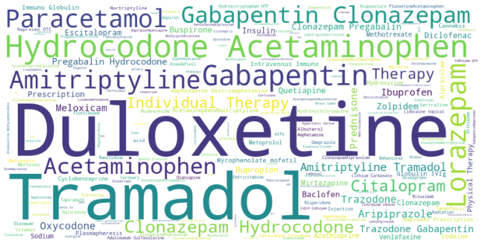
What I’ve done - treatments
372 unique treatments

Slide 9
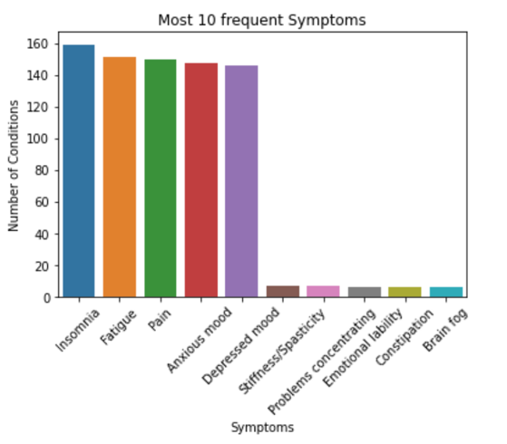
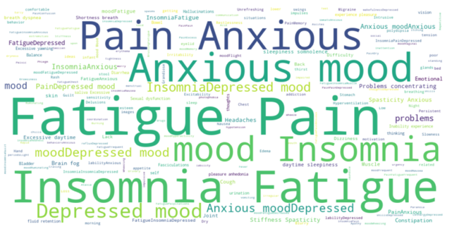
What I’ve done - symptoms
147 different symptoms

Slide 10
Future work
Train Test set split.
Prefer to use Stratify train test split to obtain dataset. However, some of the conditions only have 1 datapoint, can’t use the stratify resampling for this situation

Slide 11

Future work
Implement Collaborative filtering (CF) to find similar patients based on age, gender, symptoms, and condition.
Calculate similarity with each previous patients, filtered by age range, gender, condition, and symptoms. Sort the list of similarity, then take the top K as the
Could try different K value
Notes:
Combine the top k similar patients with their treatments.

Slide 12
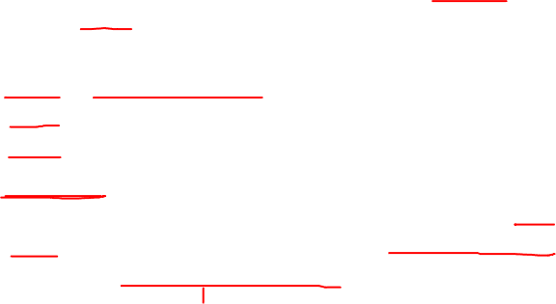
Future work
Similarity: calculating sentence similarity using a lexical database (like NLTK WordNet), which has connections between words, and corpus statistics in NLP. [11][12]
Word: Word semantic similarity. Similarity between two words, based on width (shortest path distance between the synsets of the two words)and depth(hierarchical distance of the hierarchical structure of knowledge).
Sentence: find semantic vectors based on information-content weighted words. Then, sentence semantic similarity is measured by cosine similarity of the semantic vectors. Then, use word order similarity to measure the sentence structure similarity.
Notes:
where information-content is negative correlation with the word appear frequency: high frequent words have less information, low frequent words have more information.
In some extent, like sentence “abc” and “cba”, although they have the same Bag of Words, but are totally different sentence.

Slide 13
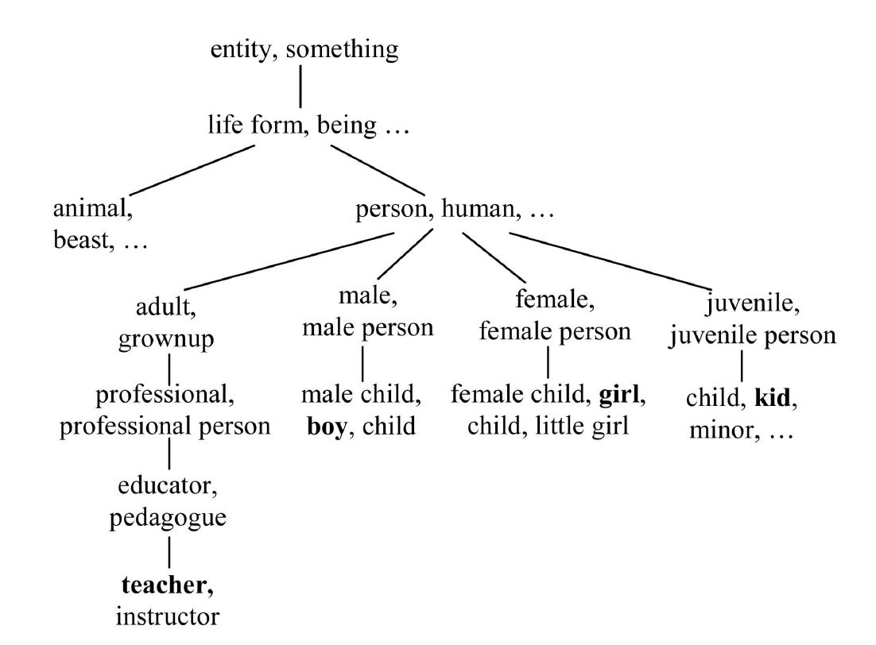
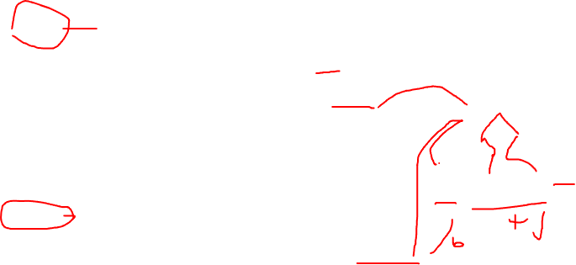
Semantic Similarity between Words
Width
1. w1 and w2 are in the same synset.
2. w1 and w2 are not in the same synset, but the synset for w1 and w2 contains one or more common words
3. w1 and w2 are neither in the same synset nor do their synsets contain any common words.
Depth
Words at upper layers of hierarchical semantic nets have more general concepts and less semantic similarity between words than words at lower layers.
Scale down upper, scale up lower
Hierarchical semantic knowledge base.
Notes:
For example, the shortest path between boy and girl in Fig. 2 is boy-male-person-female-girl, the minimum path length is 4, the synset of person is called the subsumer for words of boy and girl, while the minimum path length between boy and teacher is 6. Thus, we could say girl is more similar to boy than teacher to boy.
However, this method may be less accurate if it is applied to larger and more general semantic nets such as WordNet [26].

Slide 14
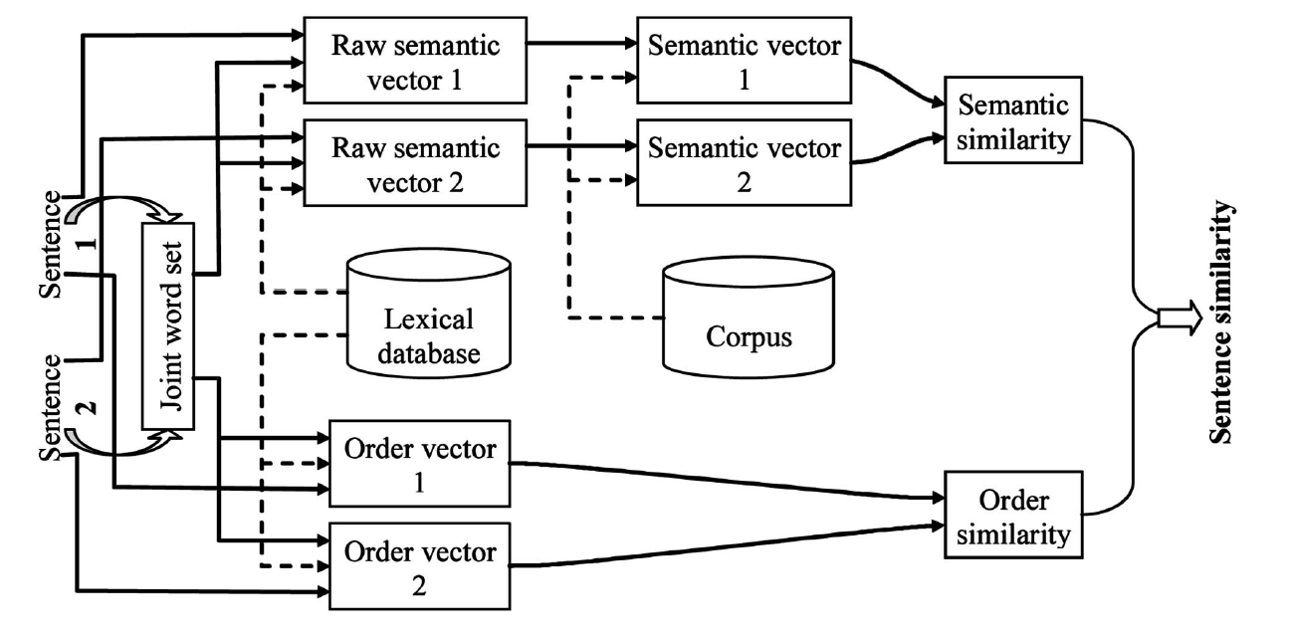

Semantic Similarity between Sentences
Use joint word set to create raw semantic vector to measure the similarity of two sentence. (0/1 vector)
Use information content to weight.
Words that occur with a higher frequency (in a corpus) contain less information than those
that occur with lower frequencies.
Sentence Order similarity
Mike eats apple.
Apple eats Mike.
Sentence similarity computation diagram
Notes:
Raw semantic vector: Use joint word set to create semantic vector, occur in joint set will be set 1
The information content of a word is derived from its probability in a corpus
Symptom is ordered based on degree, similar to a sentence, order is needed

Slide 15
Future work
Use word association to help find possible matching symptoms or conditions, so that I can detect similar terms in the medical records.
Corpus: prefer to find one related with biomedical ontology to narrow the search range.
Unified Medical Language System(UMLS) is a database of millions of medical terms grouped by concept, themselves grouped by semantic type (e.g. disease, gene, etc.)
scispaCy is a Python package containing spaCy models for processing biomedical, scientific or clinical text.

Slide 16
Future work
After finish using the symptoms and condition to recommend treatments, I will try to separate the recommendation into two stages:
First predict Conditions, then use the predict condition to recommend treatments.
Symptoms, Age, Gender -> Condition -> Treatments

Slide 17
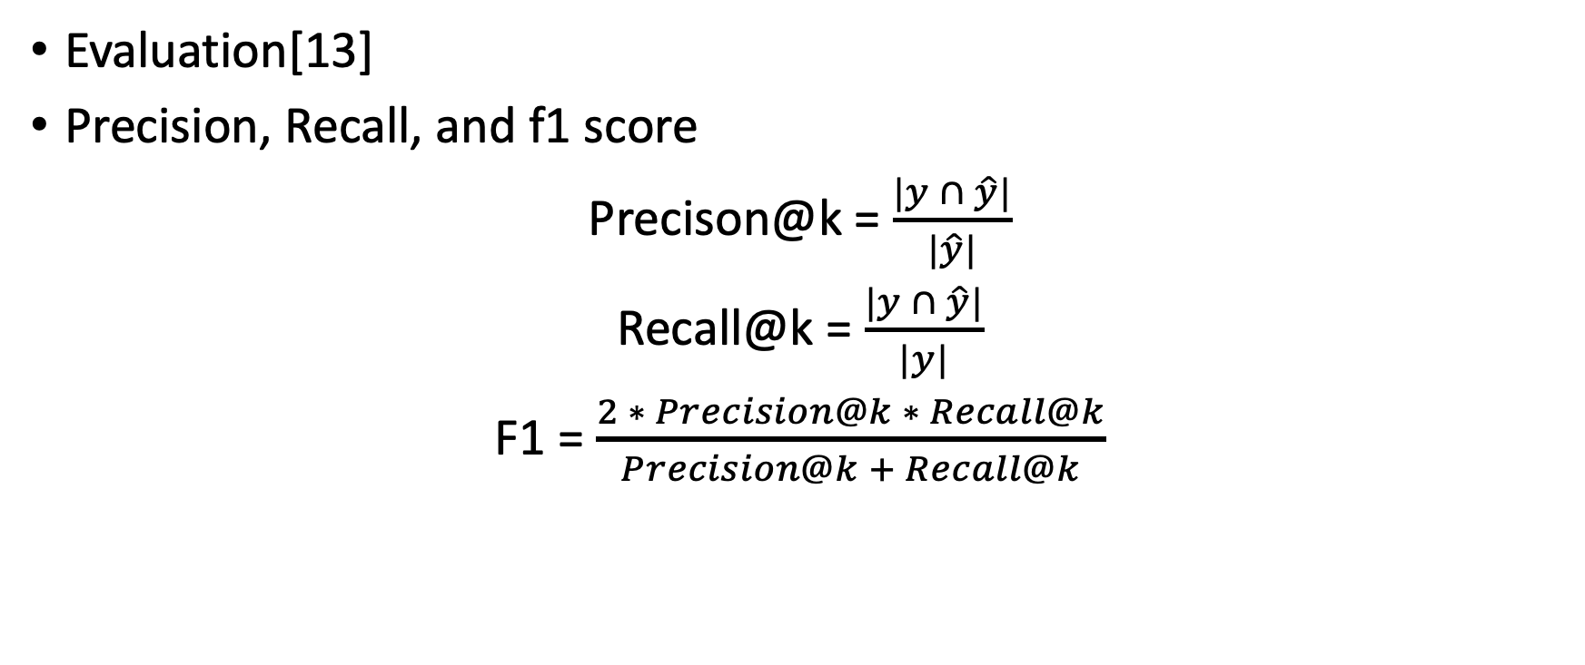
Future work
Evaluation[13]
Precision, Recall, and f1 score
Precison@k = $\frac{|y ∩ \hat{y}|}{|\hat{y}|}$
Recall@k = $\frac{|y ∩ \hat{y}|}{|y|}$
F1 = $\frac{2 ∗ Precision@k ∗ Recall@k}{Precision@k + Recall@k}$

Slide 18
Reference
[1] Ko, H., Lee, S., Park, Y., & Choi, A. (2022, January 3). A survey of recommendation systems: Recommendation models, techniques, and Application Fields. MDPI. Retrieved March 23, 2022, from https://www.mdpi.com/2079-9292/11/1/141
[2] Y. Bao and X. Jiang, An intelligent medicine recommender system framework, 2016 IEEE 11th Conference on Industrial Electronics and Applications (ICIEA), 2016, pp. 1383-1388, doi: 10.1109/ICIEA.2016.7603801.
[3] Sahoo, Abhaya Kumar, et al. “DeepReco: Deep Learning Based Health Recommender System Using Collaborative Filtering.” Computation, vol. 7, no. 2, 22 May 2019, p. 25, 10.3390/computation7020025. Accessed 8 Nov. 2019.
[4] Ali, Syed Imran, et al. “A Hybrid Framework for a Comprehensive Physical Activity and Diet Recommendation System.” Khu.elsevierpure.com, Springer Verlag, 2018, khu.elsevierpure.com/en/publications/a-hybrid-framework-for-a-comprehensive-physical-activity-and-diet-2. Accessed 24 Mar. 2022.
[5] Khoie, Mohammad, et al. “A Hospital Recommendation System Based on Patient Satisfaction Survey.” Applied Sciences, vol. 7, no. 10, 21 Sept. 2017, p. 966, 10.3390/app7100966.
[6] Gräßer, Felix & Beckert, Stefanie & Küster, Denise & Abraham, Susanne & Malberg, Hagen & Schmitt, Jochen & Zaunseder, Sebastian. (2017). Neighborhood-based Collaborative Filtering for Therapy Decision Support.
[7] Ju, Chunhua, and Shuangzhu Zhang. “Doctor Recommendation Model Based on Ontology Characteristics and Disease Text Mining Perspective.” BioMed Research International, vol. 2021, 8 Aug. 2021, p. 7431199, www.ncbi.nlm.nih.gov/pmc/articles/PMC8379386/, 10.1155/2021/7431199. Accessed 24 Mar. 2022.
[8] Han, Qiwei & Martínez de Rituerto de Troya, Íñigo & Ji, Mengxin & Gaur, Manas & Zejnilovic, Leid. (2018). A Collaborative Filtering Recommender System in Primary Care: Towards a Trusting Patient-Doctor Relationship. 10.1109/ICHI.2018.00062.
[9] “Treatment-Recommender/Crawler at Master · SooryaR/Treatment-Recommender.” GitHub, github.com/sooryaR/Treatment-Recommender/tree/master/Crawler. Accessed 24 Mar. 2022.
[10] Isinkaye, F.O., et al. “Recommendation Systems: Principles, Methods and Evaluation.” Egyptian Informatics Journal, vol. 16, no. 3, Nov. 2015, pp. 261–273, www.sciencedirect.com/science/article/pii/S1110866515000341, 10.1016/j.eij.2015.06.005.
[11] Pawar, Atish, and Vijay Mago. IEEE TRANSACTIONS on KNOWLEDGE and DATA ENGINEERING 1 Calculating the Similarity between Words and Sentences Using a Lexical Database and Corpus Statistics.
[12] Li, Yuhua & McLean, David & Bandar, Zuhair & O'Shea, James & Crockett, Keeley. (2006). Sentence Similarity Based on Semantic Nets and Corpus Statistics. IEEE Transactions on Knowledge and Data Engineering. 18. 1138-1150. 10.1109/TKDE.2006.130.
[13] Jia, Zheng, et al. “A Patient-Similarity-Based Model for Diagnostic Prediction.” International Journal of Medical Informatics, vol. 135, 1 Mar. 2020, p. 104073, reader.elsevier.com/reader/sd/pii/S1386505619310925?token=34AD41A20F588E512AA0C530C08D555695C3F9216FA2410F1784165C62E4919FB17D447F2231FDCA20E9504FEE823508&originRegion=us-east-1&originCreation=20220324073354, 10.1016/j.ijmedinf.2019.104073. Accessed 24 Mar. 2022.

Slide 19
Thanks for listening!

